Slide 1
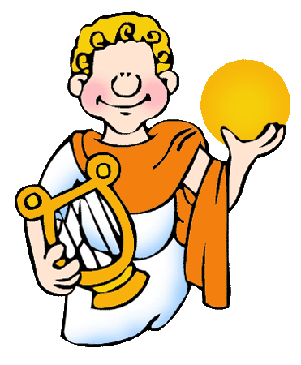
Hermes and
Apollo
An ancient
Greek myth
Retold by Lin Donn
Illustrated by Phillip Martin

Slide 2

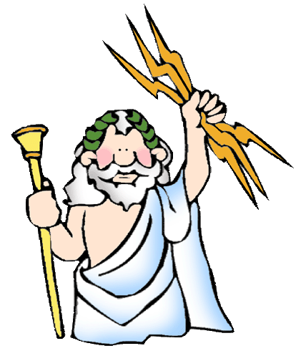
Hermes & Apollo
From the day he was born, Zeus knew Hermes was going to be a lot of fun.
Hermes was only a few days old when he climbed out of his crib and went running off by himself. How that boy could run!

Slide 3
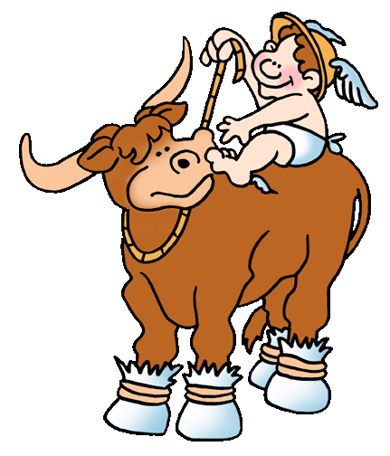
Hermes & Apollo
While he was out adventuring, Hermes spotted some cows. They were Apollo’s cows! Apollo was his big brother.
Hermes thought it would be rather funny to steal Apollo’s cows.

Slide 4
Hermes & Apollo
Hermes had the best idea! He padded the cattle’s feet and made them walk backwards to confuse the trail.
Apollo would not know which way to look for his missing cows.

Slide 5
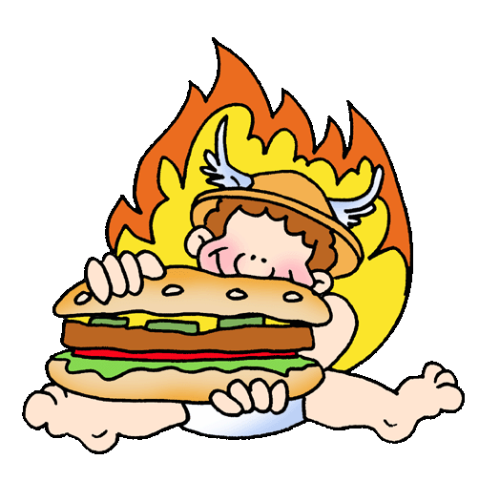
Hermes & Apollo
All that work made the baby Hermes very hungry.
He invented fire and cooked one of Apollo’s cows for lunch.

Slide 6
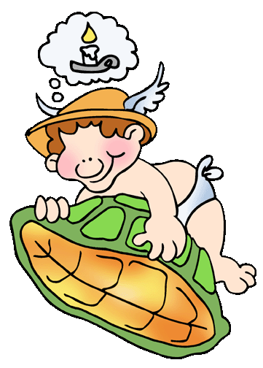
Hermes & Apollo
Hermes decided to bring all the cows home in case he got hungry again. The cows mooed musically as they ambled along.
On the way home, Hermes spotted a tortoise shell.
That gave Hermes an idea!

Slide 7
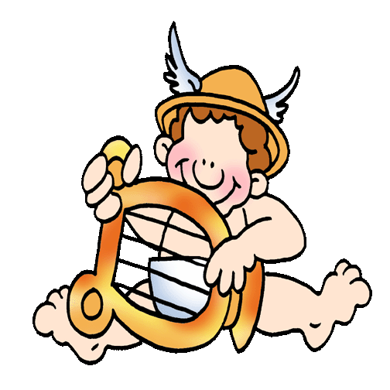
Hermes & Apollo
When he got home, Hermes made the first lyre out of the tortoise shell and string.
He was playing his new musical instrument when Apollo found him.

Slide 8
Hermes & Apollo
Apollo was furious with Hermes for stealing his cattle. No one knows what might have happened if their father had not stepped in.
“BOYS!” thundered Zeus.

Slide 9
Hermes & Apollo
To make amends, Hermes gave Apollo his tortoise shell lyre.
Apollo still carries that tortoise shell lyre, even to this day.

Slide 10

Free Clip Art &
Templates
Created by a professional and published artist, Phillip Martin, go here to find:
Free Clip Art for Ancient Greece
Free Templates for Presentations in PowerPoint format & how to use them!

Slide 11
Presentations
To learn more about ancient Greek gods, click here
We’re published! Click here to see some of the neat things we’ve written.

Slide 12
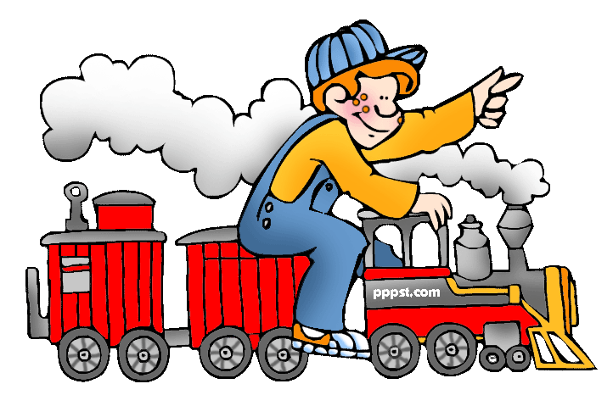
Explore …
PPPST.COM

